Slide 1
UCSD Embedded C Assignment 8
By
Hsuankai Chang
hsuankac@umich.edu

Slide 2
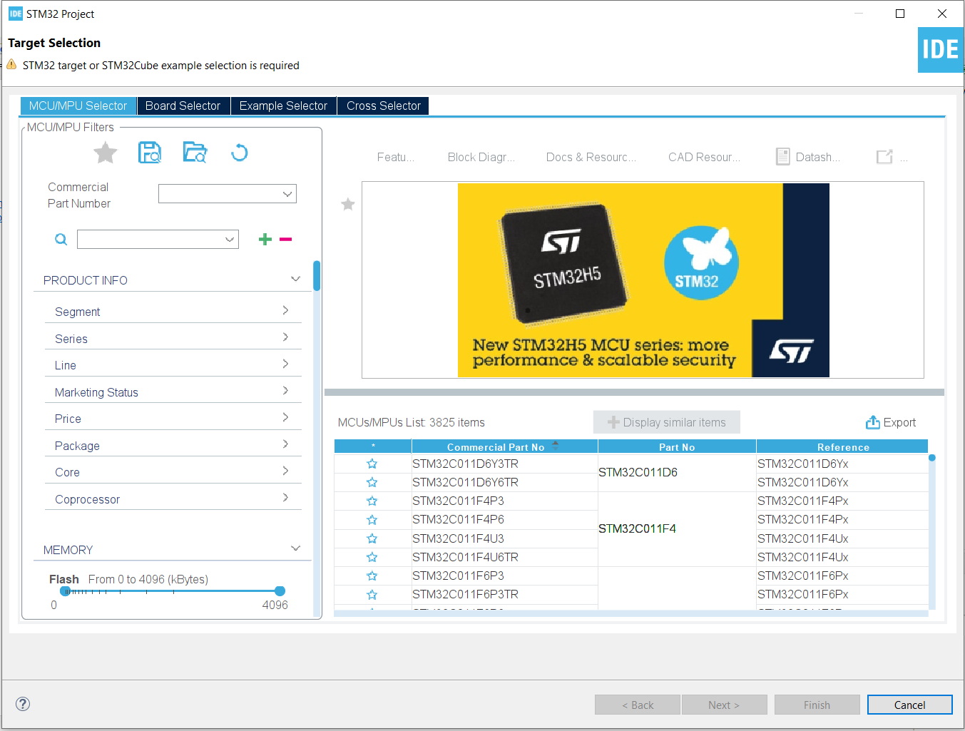
Step 1. Startup STM32CubeIDE and create new STM32 project

Slide 3
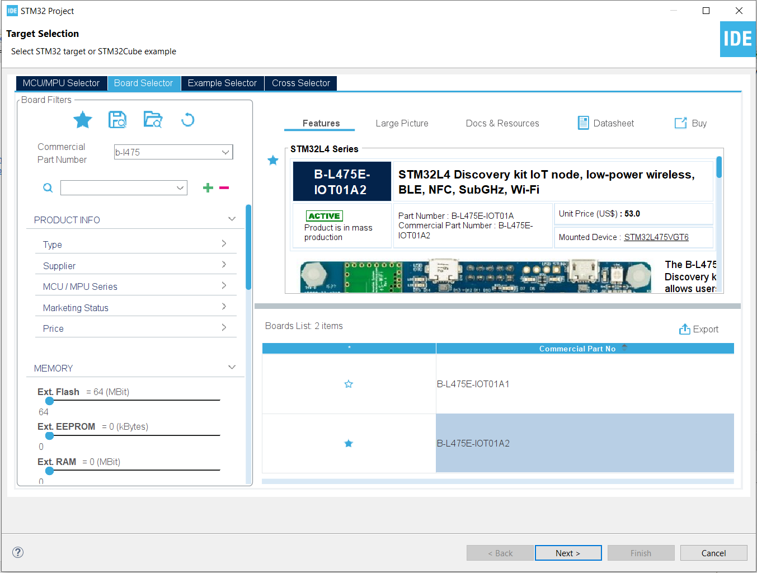
Step 2. Access board selector and type in the board you use, click Next

Slide 4
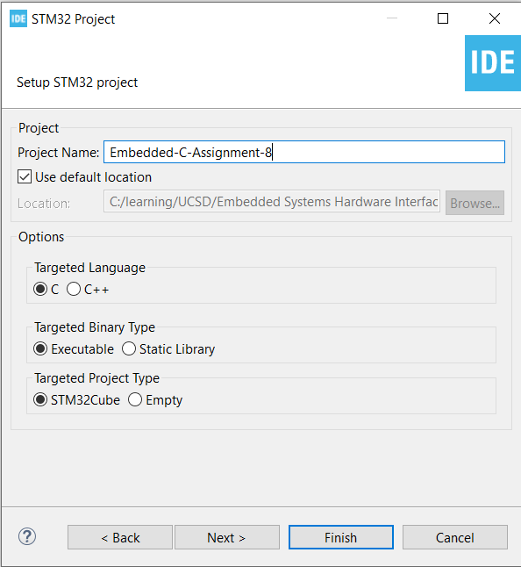
Step 3. Enter the project name then click Next

Slide 5
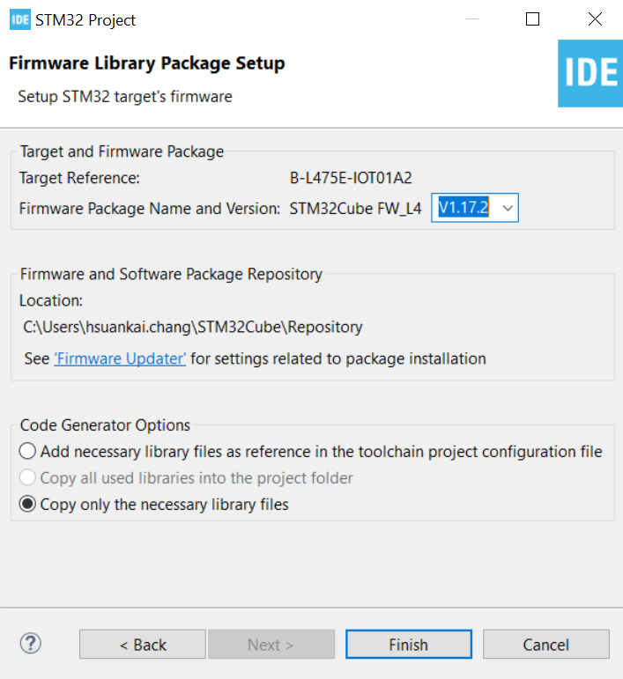
Step 4. See the firmware package name, version and location

Slide 6
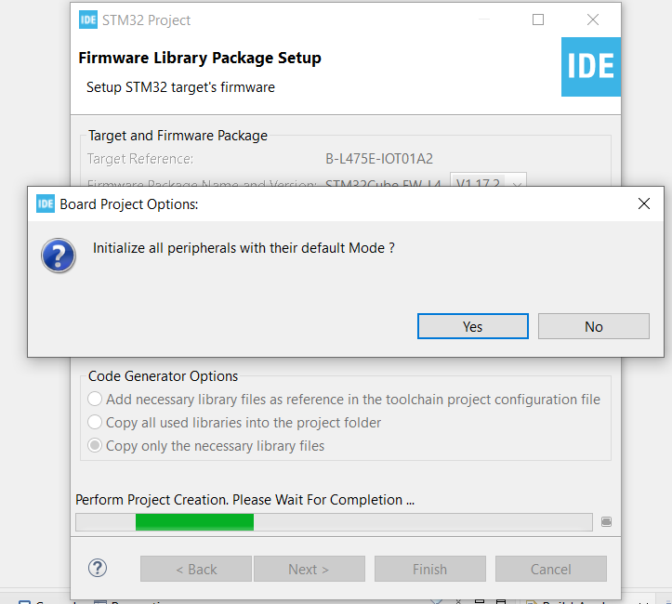
Step 5. Click yes to initialize all peripherals to default

Slide 7
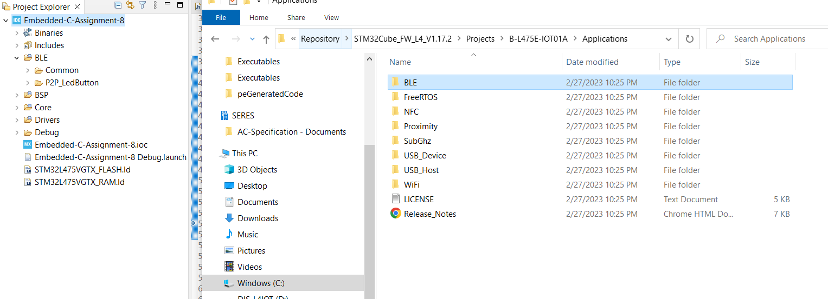
Step 6. Copy the BLE folder into the project, and delete the HeartRate folder

Slide 8
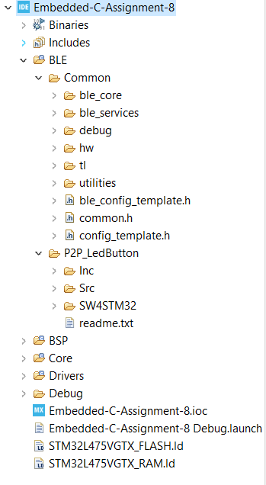
Step 7. Delete EWARM and MDK-ARM folder

Slide 9
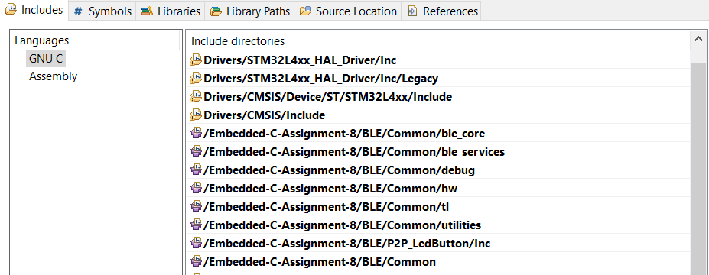

Step 8. Add the BLE source path and include path

Slide 10
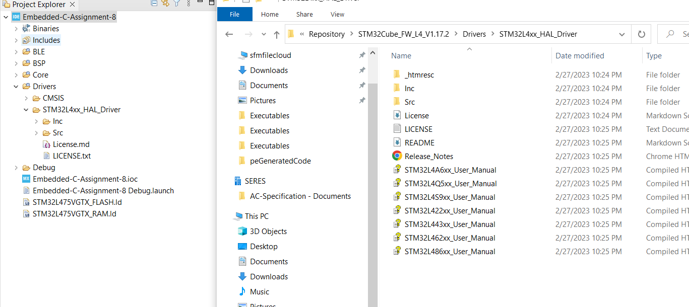
Step 9. Copy the missing LL and HAL header and source file into the project, which includes stm32l4xx_ll_pwr.h, stm32l4xx_ll_rtc.h, stm32l4xx_ll_cortex.h, stm32l4xx_ll_spi.h, stm32l4xx_ll_dma.h, stm32l4xx_hal_rtc.h, stm32l4xx_hal_rtc_ex.h

Slide 11
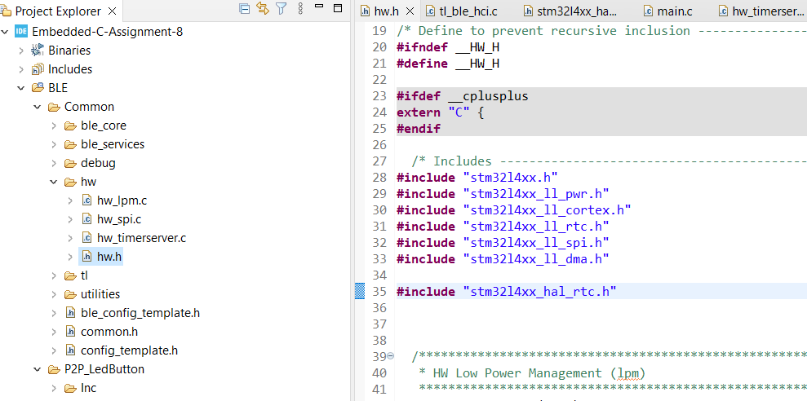
Step 10. Add stm32l4xx_hal_rtc.h in hw.h file

Slide 12
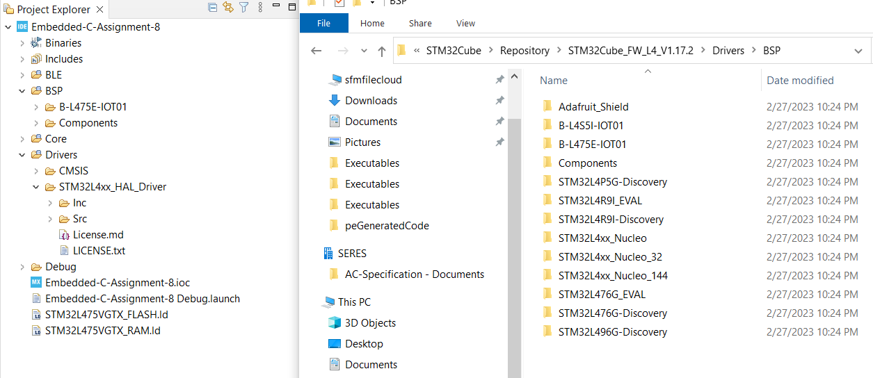
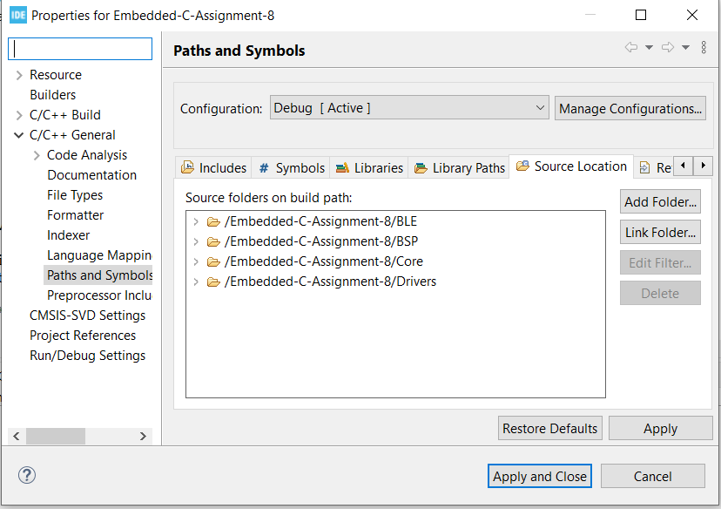
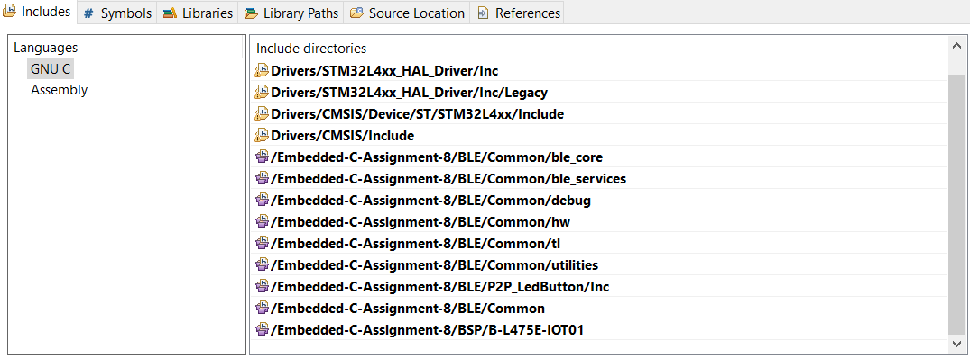
Step 11. Add BSP folders into the project, and also add the include path and source path

Slide 13
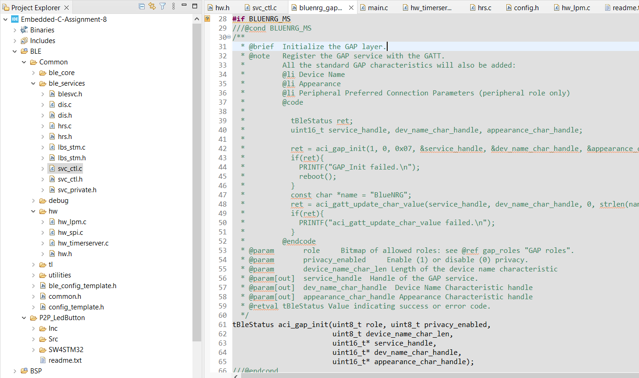
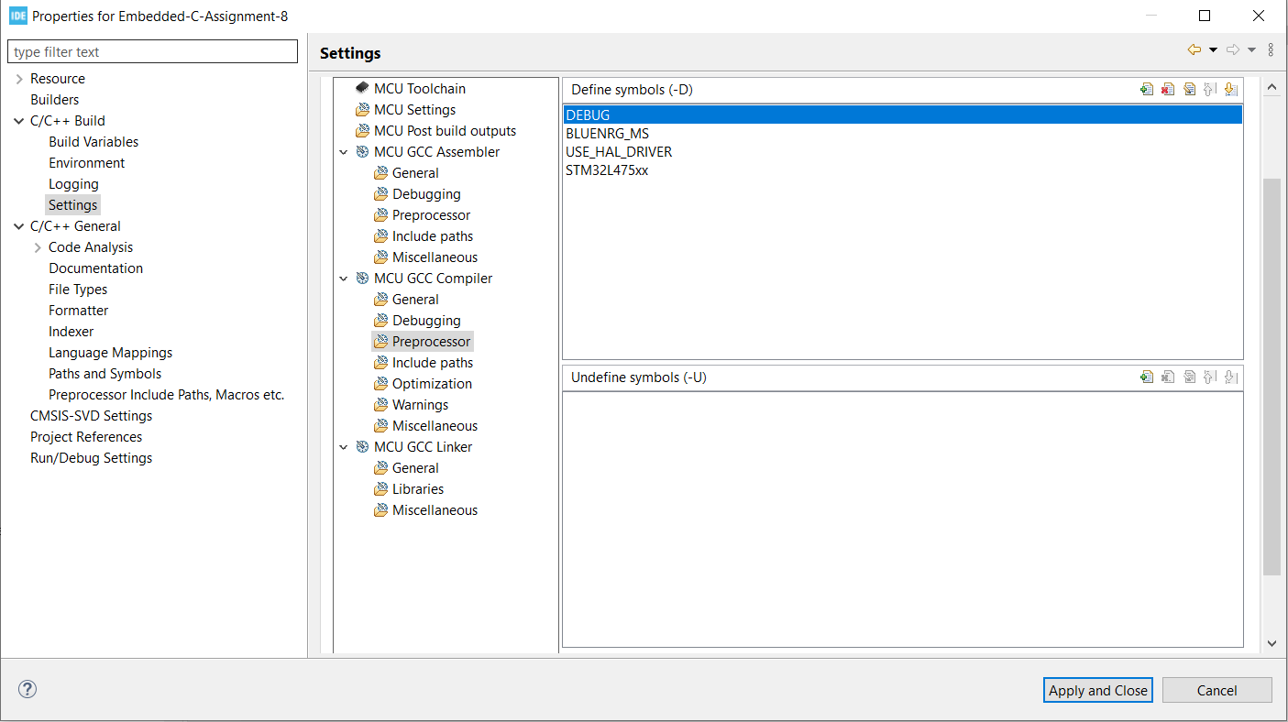
Step 12. Add BLUENRG_MS into preprocessor symbols, since our aci_gap_init function use 5 parameters

Slide 14
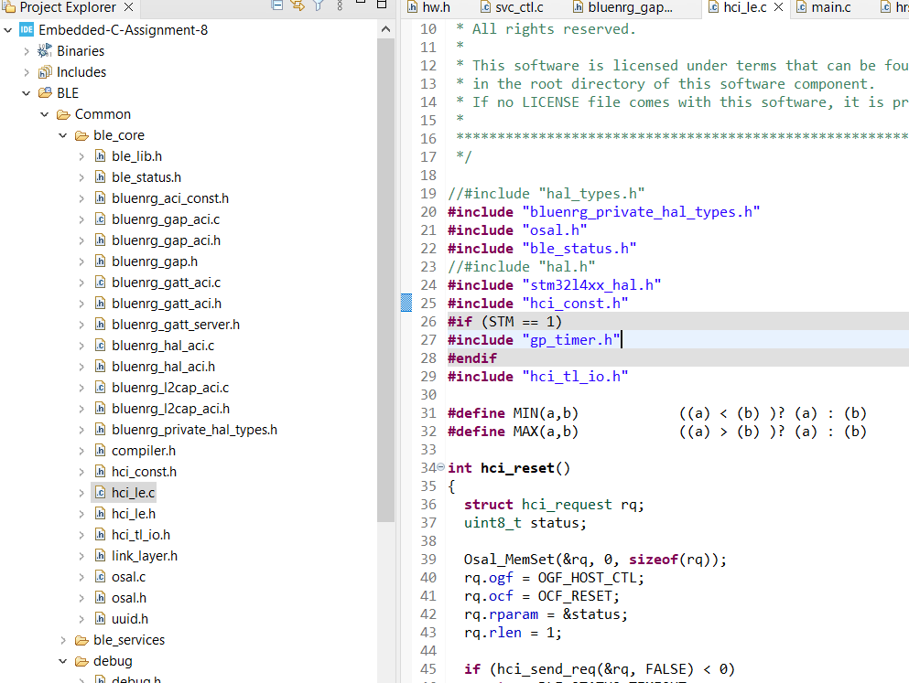
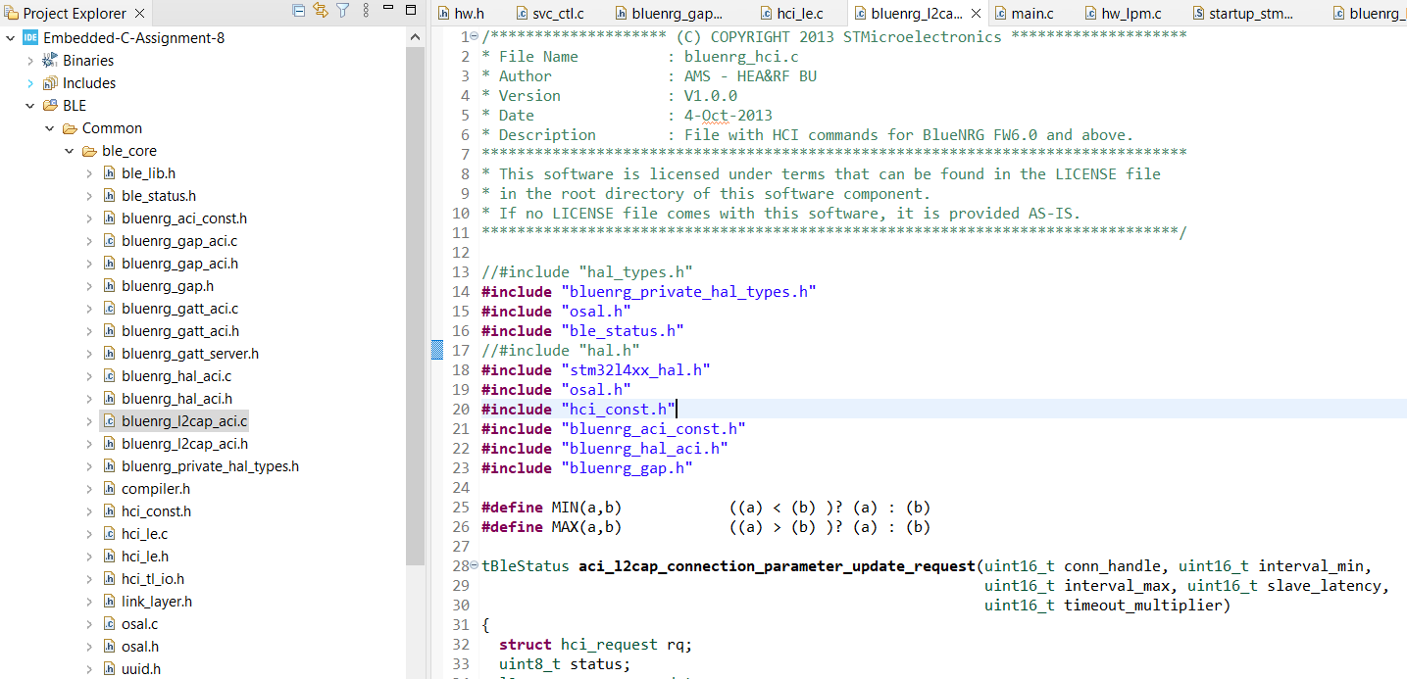
Step 13. Change the hal_types.h and hal.h include header files to bluenrg_private_hal_types.h and stm32l4xx_hal.h file in hci_ie.c and bluenrg_I2cap_aci.c file

Slide 15
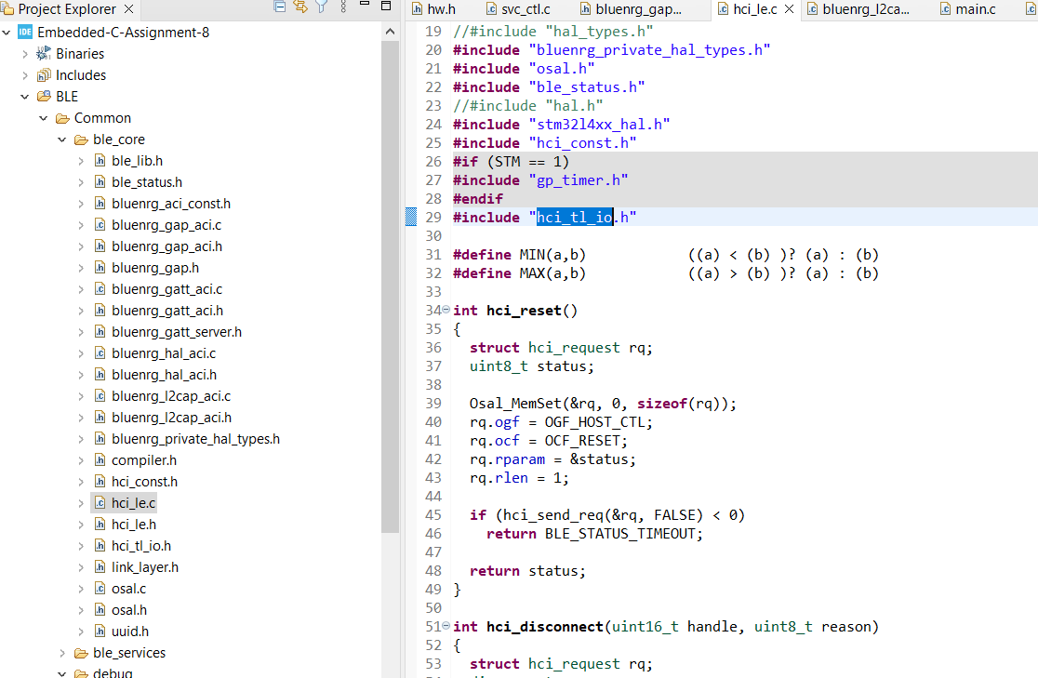
Step 14. Add hci_tl_io.h include file into hci_Ie.c file

Slide 16
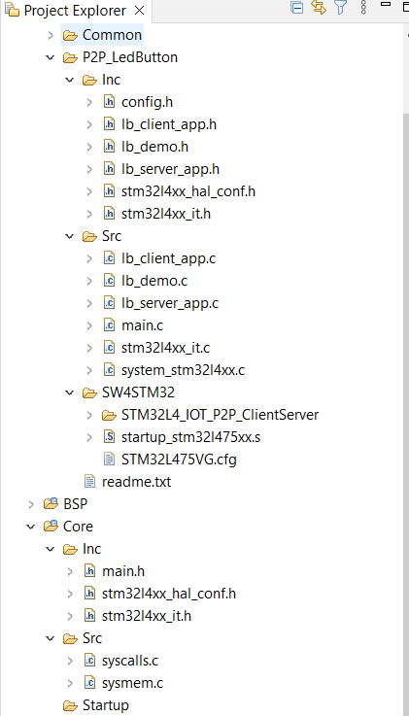
Step 15. Delete main.c, stm32l4xx_it.c, system_stm32l4xx.c, stm32l4xx_hal_msp.cand also startup file in Core folder

Slide 17
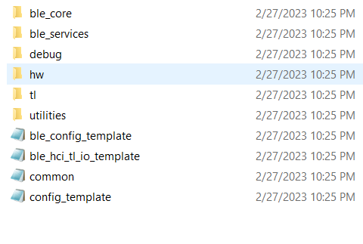
Step 16. Delete ble_hci_ti_io_template.c file to solve multiple definition of hci_send_rq function

Slide 18
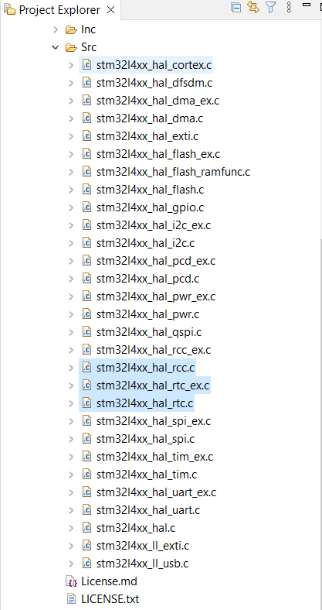
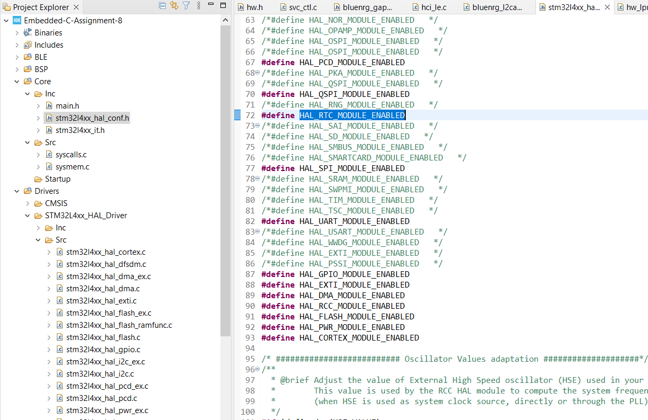
Step 17. Add stm32l4xx_hal_rcc, rtc and rtc_ex source files in driver folder, and uncomment HAL_RTC_MODULE_ENABLED to use the feature

Slide 19
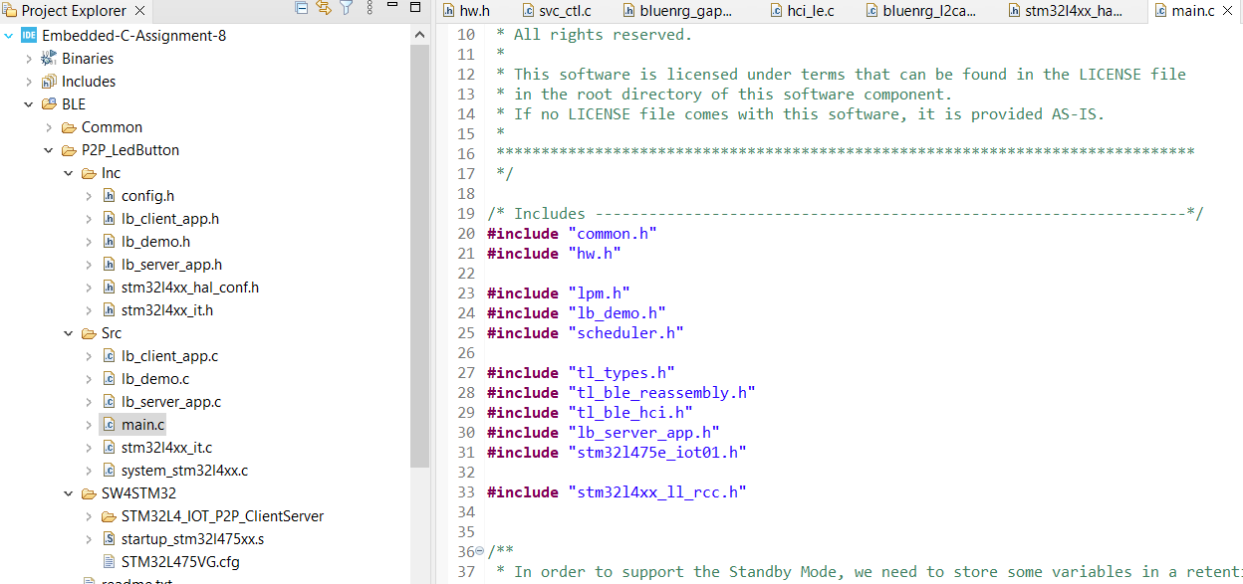
Step 18. Add stm32l4xx_ll_rcc.h file in main.c file under BLE folder to resolve LL_RCC errors

Slide 20
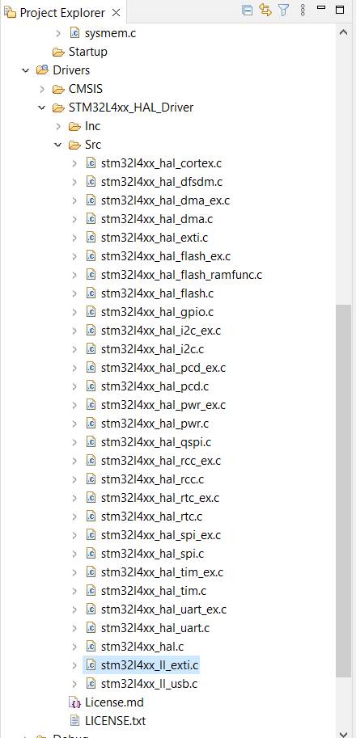
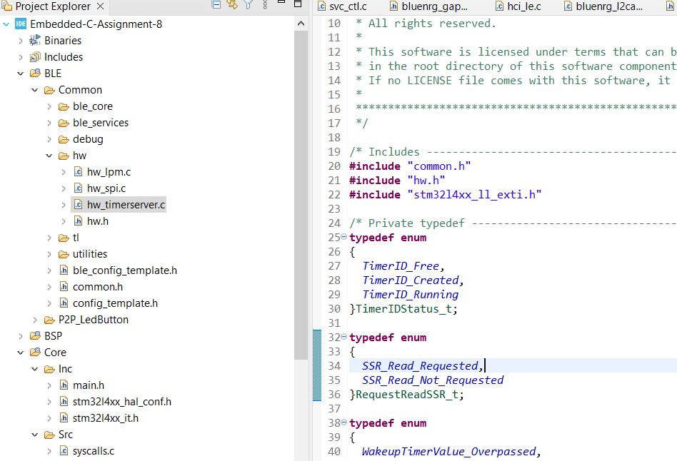
Step 19. Add stm32l4xx_ll_exit.h and .c file into driver inc and src folder, then add the header file into hw_timerserver.c file

Slide 21
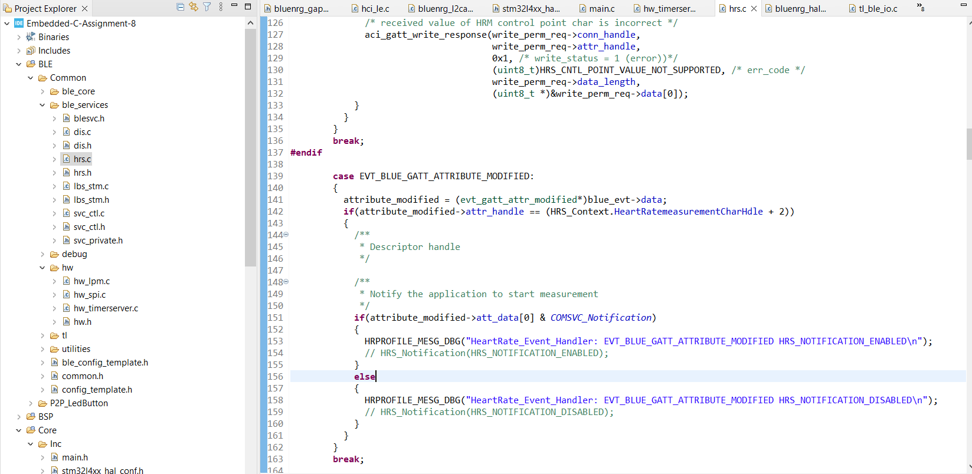
Step 20. Comment out all the HRS_Notification function in hrs.c file

Slide 22
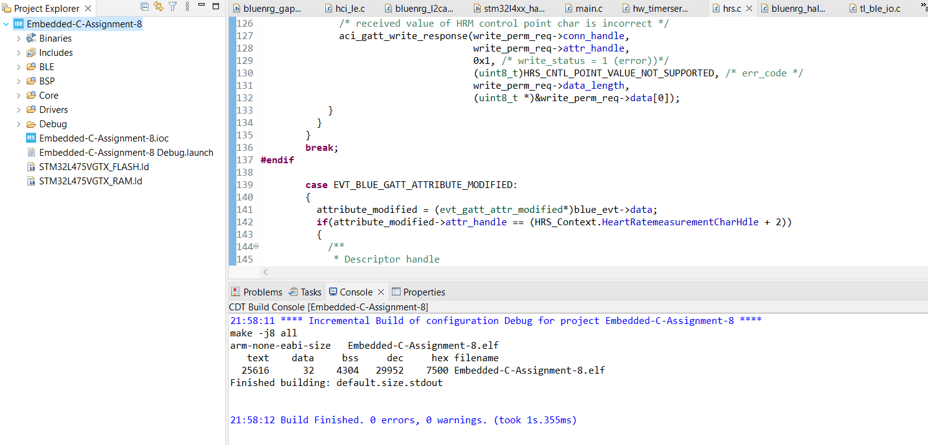
Step 21. Finally, we can build the project successfully, and when run in debug mode, we can search the Bluetooth module of our stm board

Slide 23
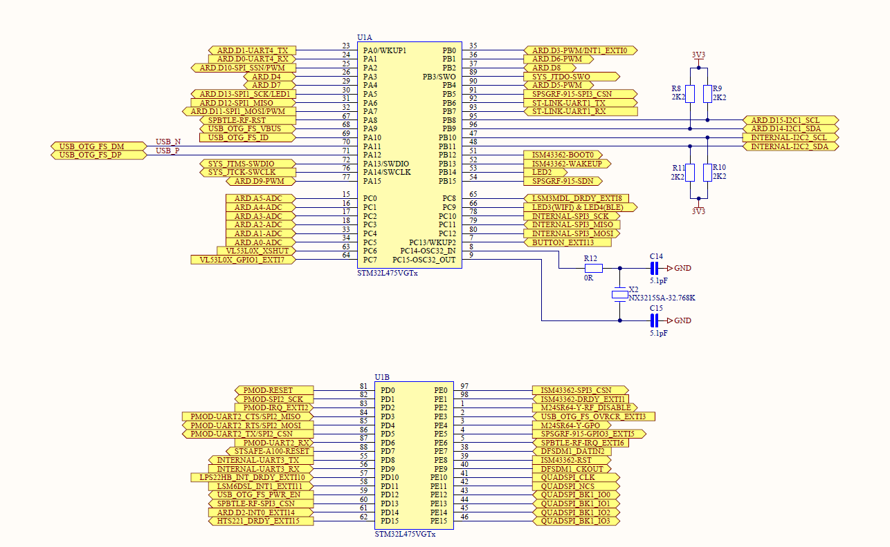
Appendix, schematic for BLE module, processor side connection

Slide 24
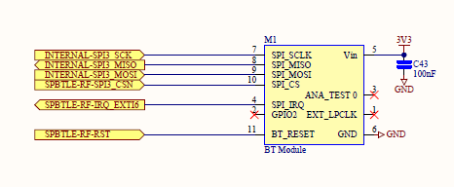
Appendix, schematic for BLE module

